Slide 1
Capstone Project
ZOMATO RESTAURANT CLUSTERING AND SENTIMENT ANALYSIS By, Srijan Rai

Slide 2
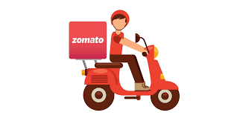
Introduction
Zomato is an Indian restaurant aggregator and food delivery start-up founded in 2008. Zomato provides information, menus and user-reviews of restaurants, and also has food delivery options from partner restaurants in select cities.
India is quite famous for its diverse multi cuisine available in a large number of restaurants and hotel resorts, which is reminiscent of unity in diversity. Restaurant business in India is always evolving.
The growing number of restaurants in every state of India has been a motivation to inspect the data to get some insights, interesting facts and figures about the Indian food industry in each city. So, this project focuses on analyzing the Zomato restaurant data for each city in India.
The Project focuses on Customers and Company, we have to analyze the sentiments of the reviews given by the customer in the data. Also, cluster the Zomato restaurants into different segments.
The Analysis also solve some of the business cases that can directly help the customers finding the Best restaurant in their locality and for the company to grow up and work on the fields they are currently lagging in.

Slide 3
Methodology
Loading the data
Data Pre-processing
Data Visualization
Preparing Data for Clustering
Clustering the Restaurants
Text Pre-processing
Sentiment Analysis on the Reviews
Conclusion
To obtain the objective of our project we will be following the methodology as described in the above diagram.
•Starting with loading the data and obtaining some basic understanding of the data.
•Proceeding with the Data pre-processing which involves Data Cleansing(handling null values, duplicates, outliers, etc.), Feature Engineering, etc.
•Data Visualization involves obtaining some important insights through necessary plots.
•After gaining some knowledge of the data we would create a data frame suitable for the clustering process.
•Clustering will be performed using different unsupervised machine-learning algorithms.
•After the clustering we will proceed with the sentiment analysis, starting with some text pre-processing tasks.
•We would carry out sentiment analysis through various supervised machine-learning algorithms.
•After all the above processes, necessary conclusion would be obtained for our project.

Slide 4
Understanding the data
Zomato Restaurant names and Metadata
Name : Name of Restaurants
Links : URL Links of Restaurants
Cost : Per person estimated Cost of dining
Collection : Tagging of Restaurants w.r.t. Zomato categories
Cuisines : Cuisines served by Restaurants
Timings : Restaurant Timings
Zomato Restaurant reviews
Restaurant : Name of the Restaurant
Reviewer : Name of the Reviewer
Review : Review Text
Rating : Rating Provided by Reviewer
MetaData : Reviewer Metadata - No. of Reviews and followers
Time: Date and Time of Review
Pictures : No. of pictures posted with review

Slide 5
Exploratory Data Analysis(EDA)
Data Exploration
Metadata Data frame:
The shape of this data frame is (105,6). Hence there are 105 entries and 6 features.
No duplicates in the data frame
There are many null values under the collections feature. For the null values under collections, we would replace them with "No Collection", because these restaurants belong to no collections.
Feature Engineering: Links and Timings features are dropped from the data frame, as these are not required for further analysis. Also, new feature called “Number of Cuisines” is added into the data frame
Reviews Dataframe:
The shape of this data frame is (10000, 7), hence there are 10000 entries and 7 features.
There are 36 duplicates in the data frame. These duplicates will be dropped.
Dropping all the null values from this data frame, as the percentage of null values are negligible.
Feature Engineering: Adding new features called “Day, Hour, No_Of_Review, No_of_Followers” into the data frame.

Slide 6
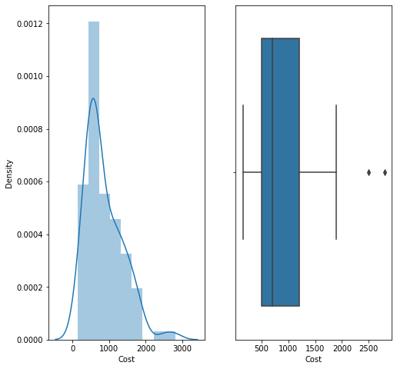
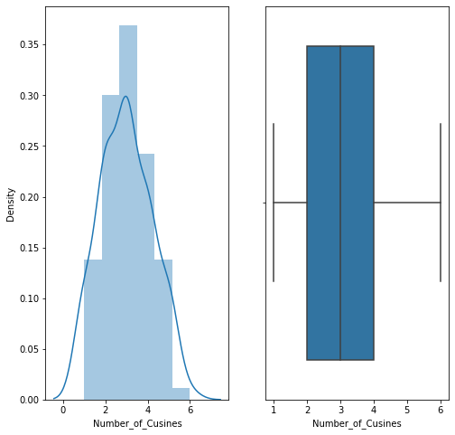
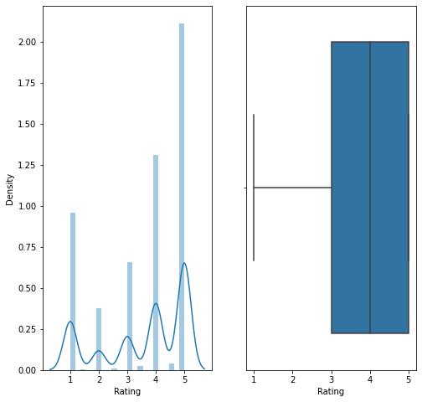
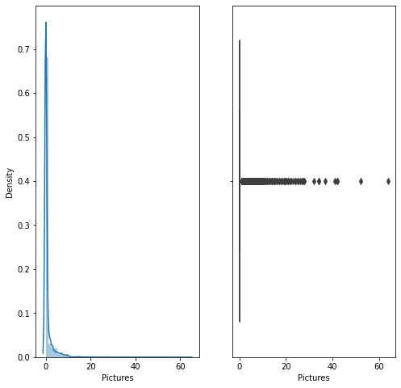
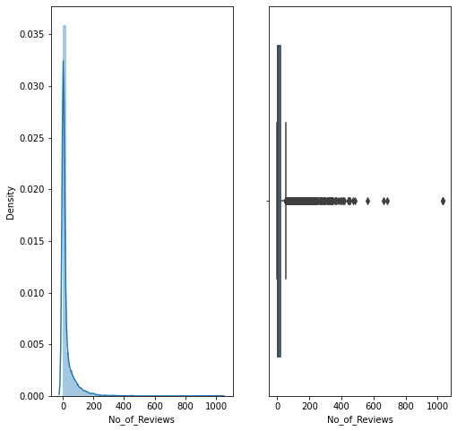
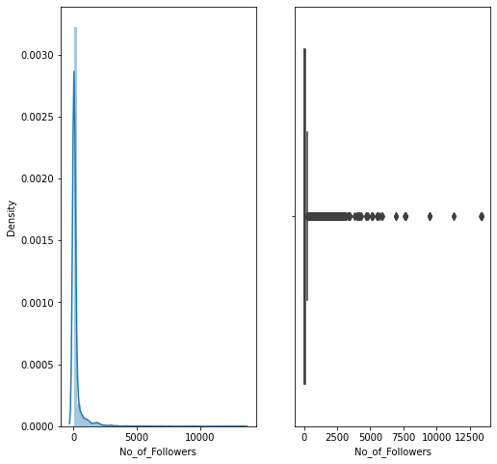
EDA – Outlier Detection

Slide 7
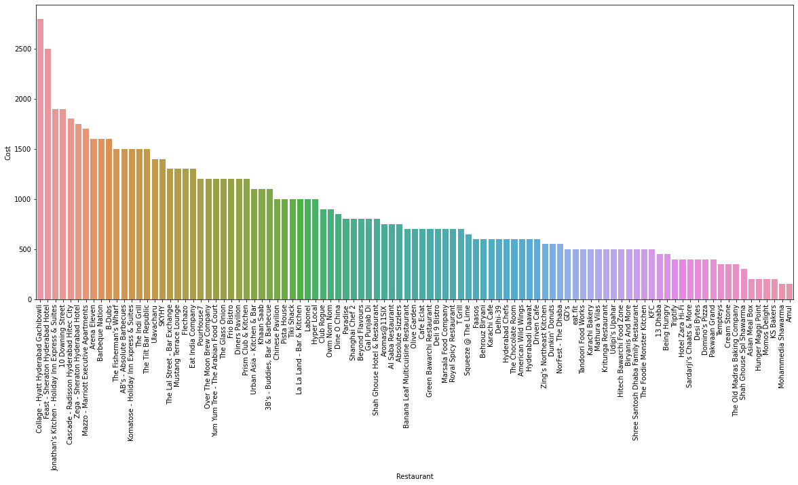
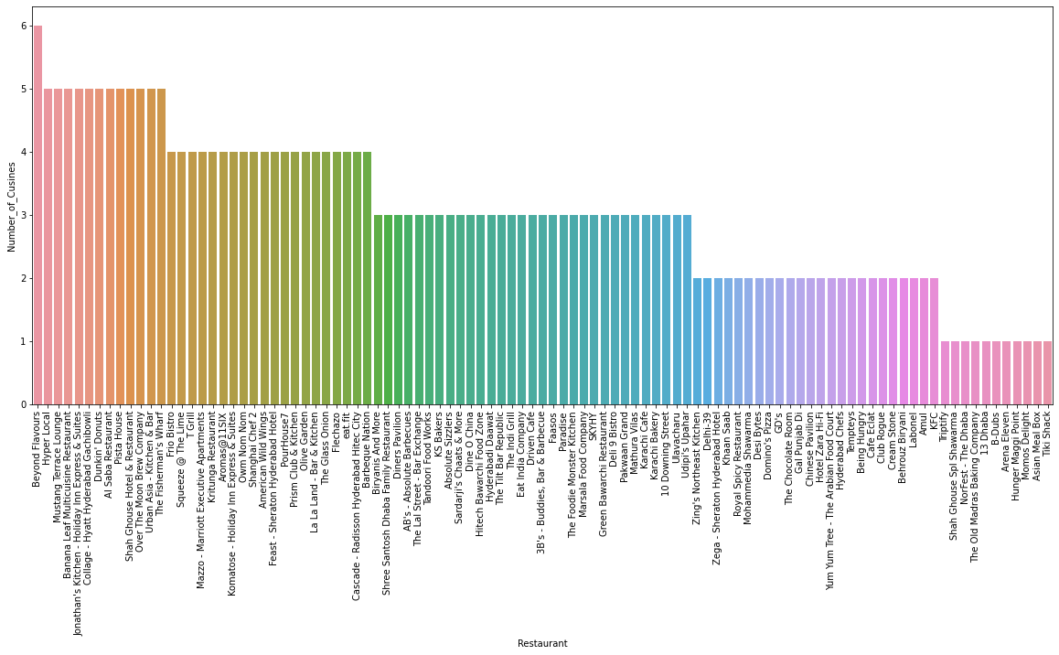
EDA - Data Visualization

Slide 8
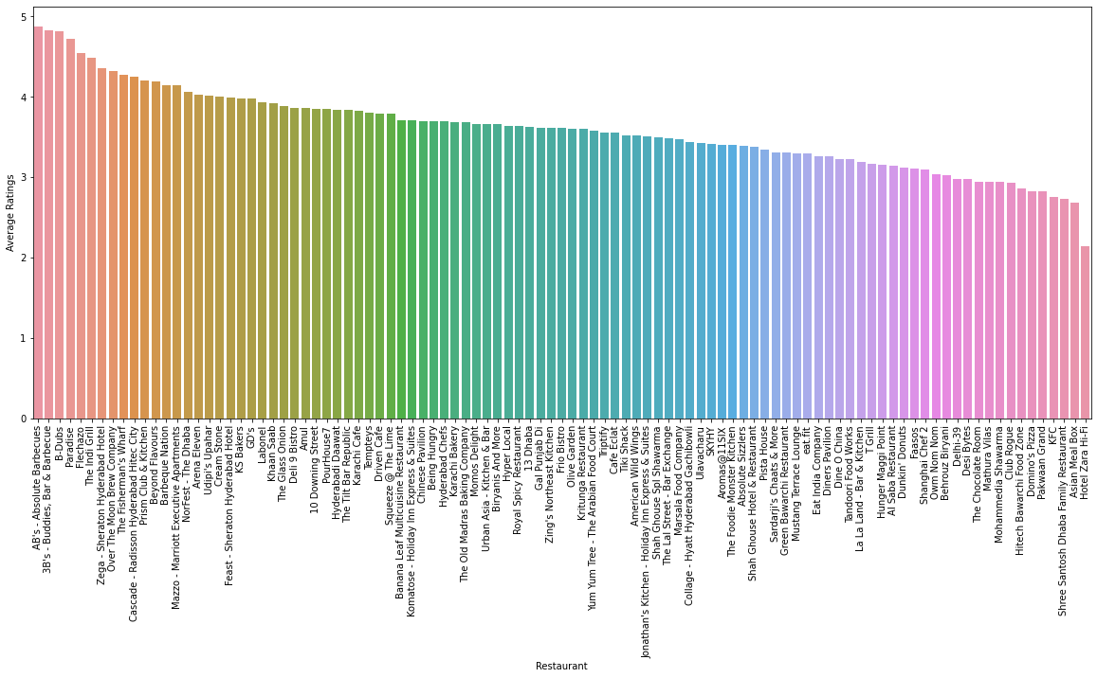
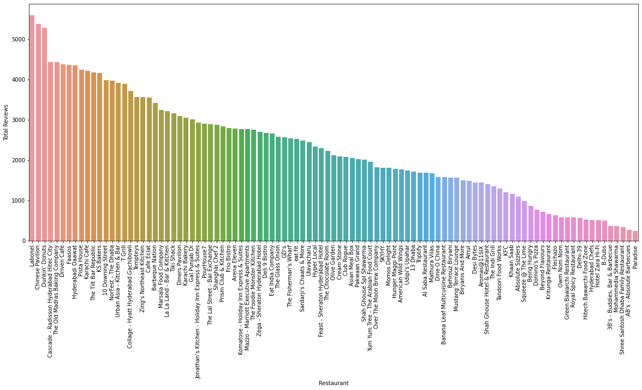
EDA - Data Visualization

Slide 9
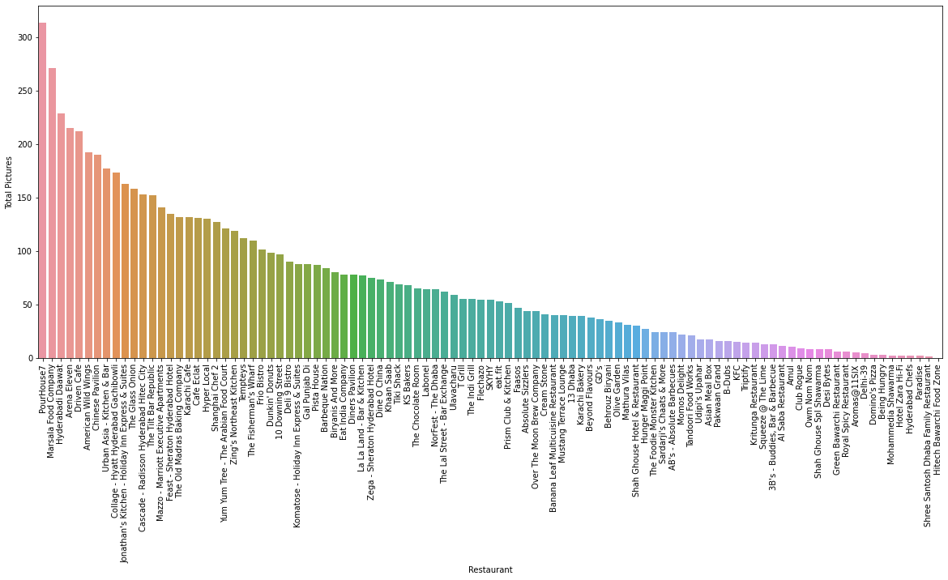
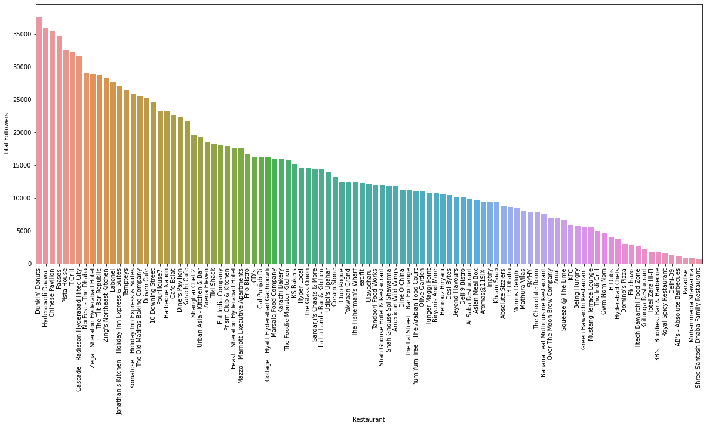
EDA - Data Visualization
Notes:
The number of data decreases as the education class increases.
More Males are prone to cardiovascular risk than females.
Smoking increases cardiovascular disease risk.
The data contains more number of people who do not have any BP medications. However, people with BP medications are more prone to the cardiovascular risk.
Hypertensive people are more prone to cardiovascular risks.
The are more non-diabetic people in the data frame. However diabetic people are having higher cardiovascular risk.

Slide 10
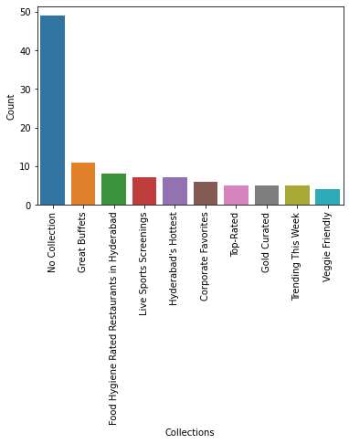
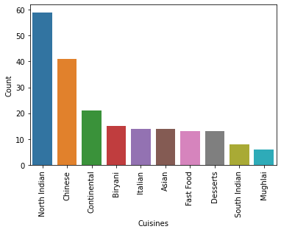
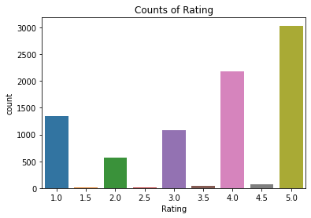
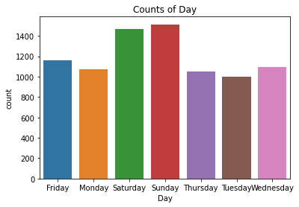
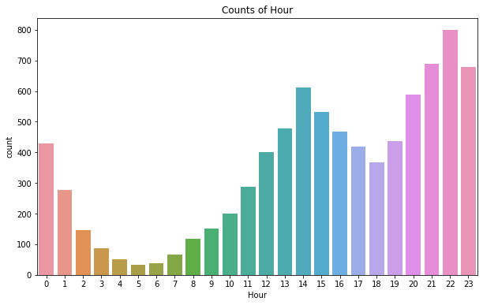
EDA - Data Visualization

Slide 11
Restaurant Clustering
Clustering is an unsupervised machine learning technique where similarity between the observations is determined using inter observation distance measures. Hence creating different clusters for the data.
Hypothesis for the given data:
Restaurants with similar kinds of ratings can be clustered together. Ratings are done by people on the basis of food quality, service, packaging among other things.
Restaurants with high ratings would also probably be expensive and would be having a similar pricing strategy as well. They can be clustered according to the costs. Hence we will create clusters using the price and ratings
Restaurants having similar cuisines can be clustered together.
Clustering Algorithms:
K-Means Clustering
Hierarchical Clustering
Feature Engineering:
We would be adding new features, i.e. different cuisines present in the data, these are dichotomous features, representing whether the particular cuisine is present or not.

Slide 12
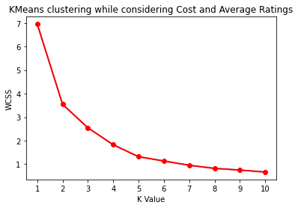
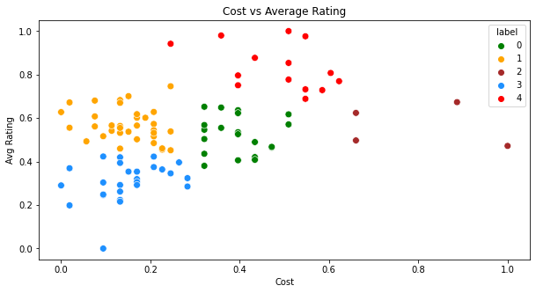
K-Means Clustering (Cost and Ratings)
Label 0 are the restaurants with good rating and average pricing.
Label 1 are the restaurants with low pricing and good rating.
Label 2 are some expensive restaurants with good rating.
Label 3 are the restaurants with low rating and low pricing.
Label 4 are the restaurants whith high rating and average pricing.

Slide 13
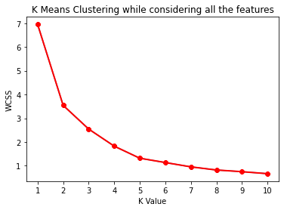
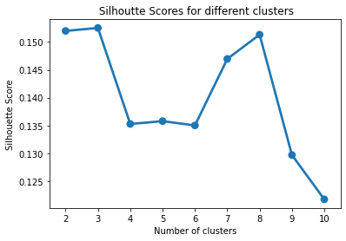
K-Means Clustering (Cuisines)
The above elbow curve do not provide us a good insight in determining the number of clusters, So we would be using the Silhouette score of different clusters to obtain the optimum number of clusters.
From the above plot we would consider the optimum number of clusters as 3.

Slide 14
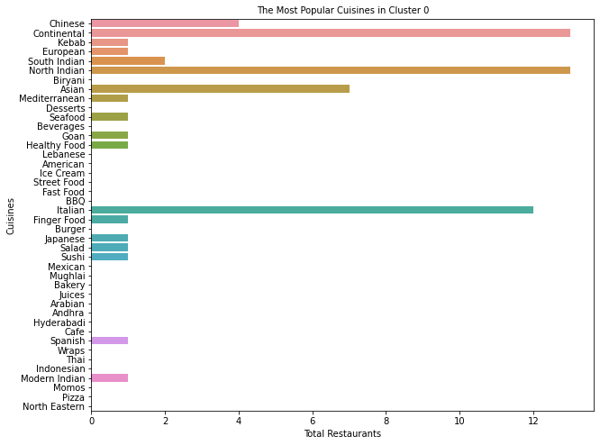
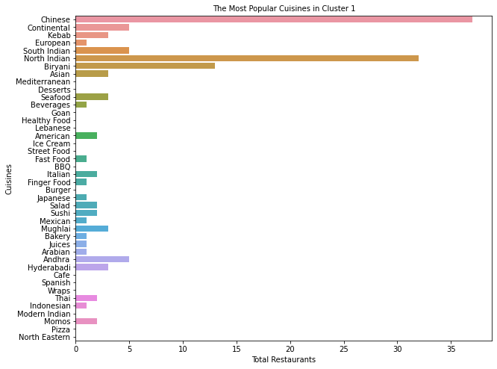
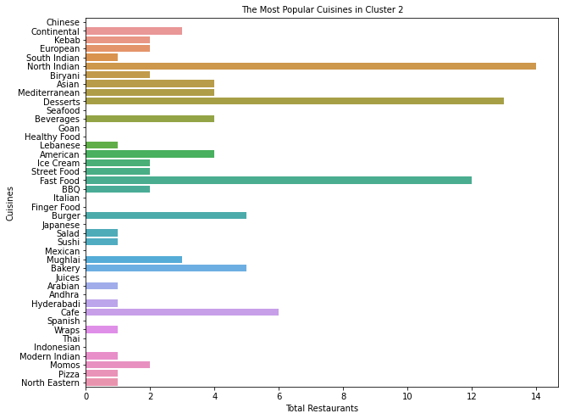
K-Means Clustering (Cuisines)
Cluster 0 are the type of restaurants that serve healthy food and hence these restaurants can be targeted to highly health-conscious people.
Cluster 1 consists of restaurants that serve moderately healthy food, these restaurants would be recommended for casual dining.
Cluster 2 consists of restaurants that serve unhealthy food such as Junk foods, bakeries, street food, etc. Most of the fast-food restaurants belong to these restaurants.
Cluster 0 restaurants have a high average rating and a high average cost. Also, the number of restaurants is very limited.
Cluster 1 restaurants have a low rating and average cost and have a considerable amount of restaurants.
Cluster 2 restaurants have a moderate rating and a very low price and have more number of restaurants compared to other clusters.

Slide 15
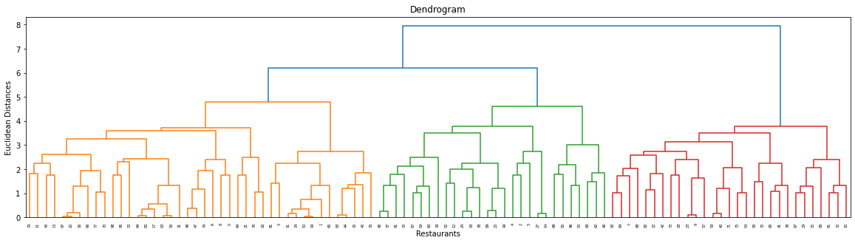
Hierarchical Clustering

Slide 16
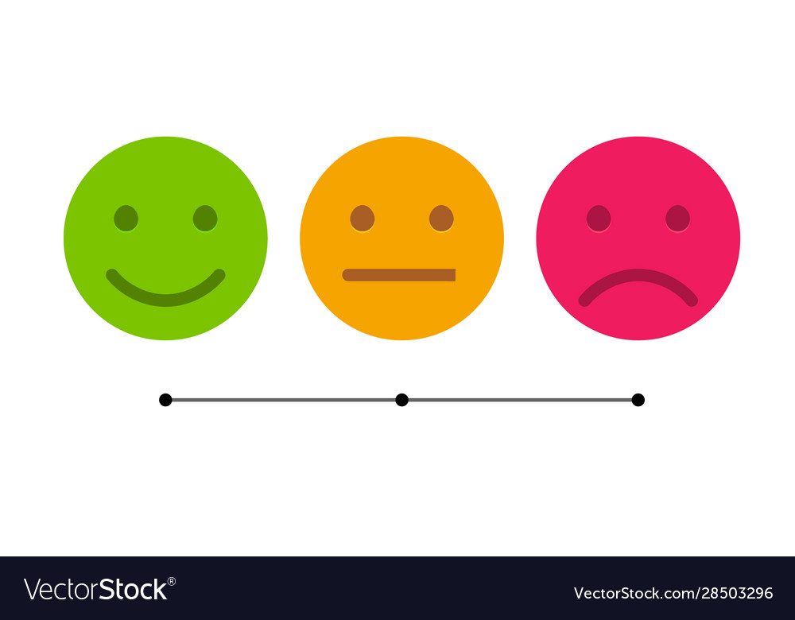
Sentiment Analysis
Sentiment Analysis is the most common text classification tool that analyses an incoming message and tells whether the underlying sentiment is positive, negative our neutral.
Data Pre-processing:
Creating the new "Sentiment" feature, where it will return the sentiment as positive when the rating is equal to or above 3.5, and negative when it is below 3.5
Text Pre-Processing:
Remove newline(\n) tags
Remove html tags
Transform the emojis to its respective text form
Remove punctuation
Remove numbers from the reviews
Remove brackets from the reviews
Converting the reviews to lower case
Stop-word Removal:
Stop words are available in abundance in any human language. By removing these words, we remove the low-level information from our text in order to give more focus to the important information.

Slide 17
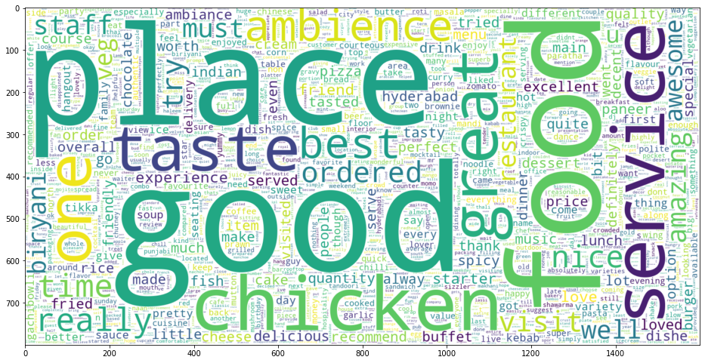
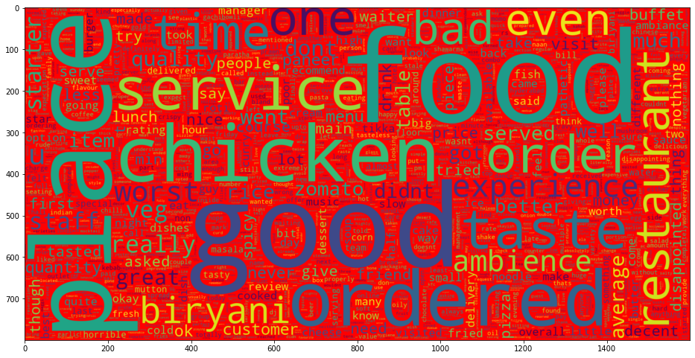
Sentiment Analysis - WordClouds

Slide 18
Sentiment Analysis – Machine Learning Models
Stemming:
Stemming is a natural language processing technique that lowers inflection in words to their root forms, hence aiding in the preprocessing of text, words, and documents for text normalization.
We would we using the snowball stemmer offered by nltk.
Train Test Split:
Train size – 75%, Test size – 25%
TFID Vectorization:
TF-IDF is an abbreviation for Term Frequency Inverse Document Frequency. This is very common algorithm to transform text into a meaningful representation of numbers which is used to fit machine algorithm for prediction
ML Models:
LogisticRegression
DecisionTreeClassifier
GradientBoostingClassifier
RandomForestClassifier
XGBClassifier
KNeighborsClassifier
Support Vector Classifier (SVC)
Naive Baye's

Slide 19
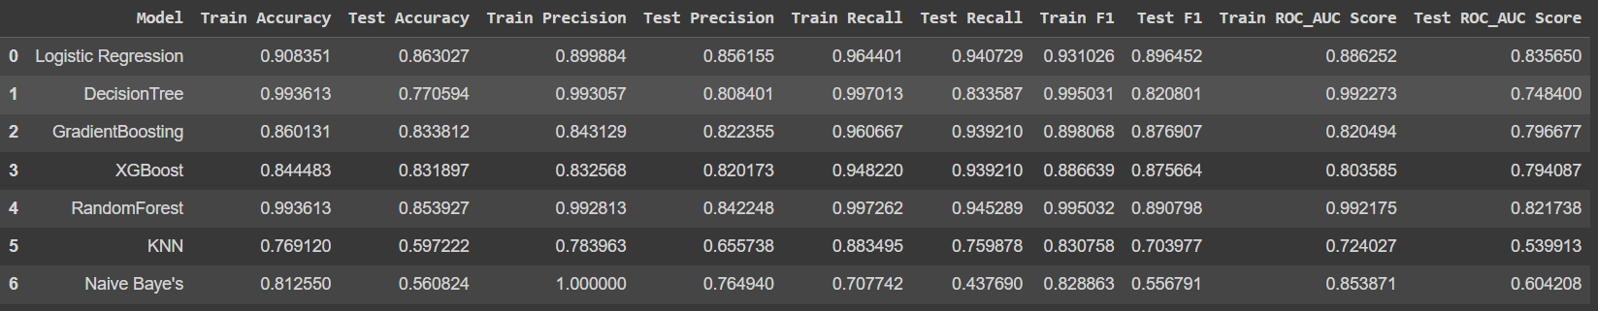
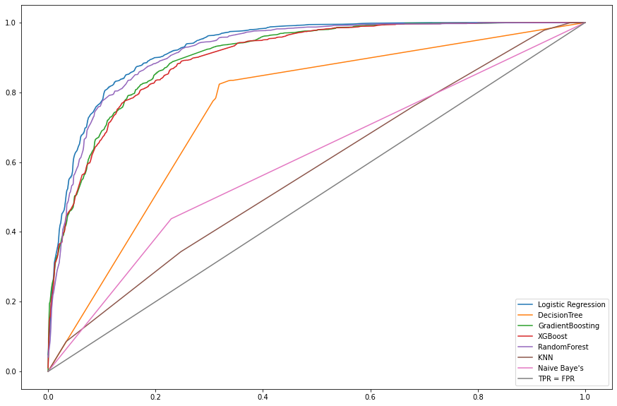
Machine Learning Models – Evaluation metrics &
AUC-ROC

Slide 20
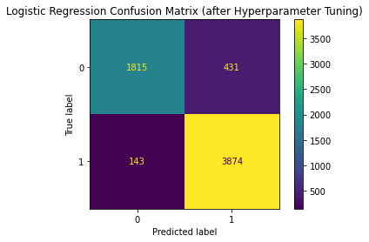

Hyper-Parameter Tuning
GridSearchCV cross-validation method will be used to perform the hyperparameter tuning.
Number of Cross-Validations: 5
Scoring: ROC-AUC-Score
Model | Hyperparameters | Best_Parameters
Logistic Regression | 'solver' : ['newton-cg', 'lbfgs', 'liblinear'],'penalty': ['l1', 'l2', 'elasticnet'], 'C': [100, 10, 1.0, 0.1, 0.01] | 'C': 1.0, 'penalty': 'l2', 'solver': 'liblinear'

Slide 21
Sentiment Analysis – Final Outcome
We have carried out all the above steps and also used the best selected model to obtain the sentiments of some custom reviews to verify our final model.
Reviews | Outcome from the model (Sentiment)
It's a great experience. The ambiance is very welcoming and charming. Amazing wines, food and service. Staff are extremely knowledgeable and make great recommendations. | The sentiment of the review is Positive
"Awful. Service from start to finish was not good. Food was okay. Paid for a meal for 3, & immediately after finishing our food we were continuously asked to leave our table. When we said no (because we paid to be there) we were met with a guilt trip, rolled eyes, and heavy sighs. | The sentiment of the review is Negative

Slide 22
Conclusion
From the above data analysis, clustering and sentiment analysis on various restaurants and their reviews, the following observations were acquired:
Bar plots were obtained to visualize various parameters for all the restaurants and top 5 restaurants in different parameters were obtained.
Majority of the restaurants serve north Indian cuisines.
Most of the people order food on weekends.
We have obtained 5 different clusters of restaurants when we considered their ratings and cost.
3 different clusters of restaurants were obtained that serve healthy, moderately heathy and unhealthy food respectively.
Sentiment analysis was carried out on the reviews posted by the users.
Logistic Regression model was the best suited model to carry out the sentiment analysis on the given data.

Slide 23


